Slide 1
Present Perfect Simple
Form and use

Slide 2
Basic rules on how to form Present Perfect Simple

Slide 3
Shortened forms
I have = I‘ve
I have been here since last week = I‘ve been here since last week.
She has just gone out = She‘s just gone out.
I haven‘t seen Peter = I‘ve not seen him = I have not seen him.

Slide 4
Present Perfect Simple: have / has + Past participle
I have eaten
You have eaten
He has eaten
She has eaten
It has eaten
We have eaten
You have eaten
They have eaten
I haven’t eaten
You haven’t eaten
He hasn’t eaten
She hasn’t eaten
It hasn’t eaten
We haven’t eaten
You haven’t eaten
They haven’t eaten
Have I eaten
Have you eaten
Has he eaten
Has she eaten
Has it eaten
Have we eaten
Have you eaten
Have they eaten

Slide 5
Present Perfect vs. Past Simple
If the time is defined Past Tense is to be used
Compare:”Where you (BE) __________yesterday?”
“Where (you/be) ____________?”
I didn’t see Peter at the party last night.
I’ve never seen Peter before.

Slide 6
When to use Present Perfect?
For actions that happened – but either we do not know when or it is not important when:
I have been in London twice. - no time given
Similar are the actions which reflect / show RESULTS:
I‘ve broken my leg!
I‘ ve made a mistake.
I‘ve read the book.
For actions that began in the past and still go on – EXPERIENCE
I have lived in Slovenia for ten years.
I have been at this schoool for nine years.

Slide 7
Adverbs of time with Present Perfect
yet – negative sentences and questions
already
just
ever / never
before
so far
recently
since
for
But also:
Today
I haven‘t seen Peter today.
I haven‘t seen him SINCE last week.
I haven‘t seen him FOR six days.
I haven‘t seen him FOR AGES.
BUT:
I didn‘t see Peter at school last week.
I saw him when we were at John‘s party.

Slide 8
‘‘SINCE‘‘ and ‘‘FOR‘‘
Try to answer some of the questions below:
How long have you had English?
I‘ve had it for five years.
Can you explain the sentence in English?
I started learning English five years ago and I am still learing it.
How long have you known your English teacher?
I‘ve known her for two years. Means = …
We met two years ago and now we know each other.
HOW LONG have you been at this school?
I have been at this school _______ 2002.
I have been at this school SINCE 2002.
That is 8 years!
Yes, I have been at this school for eight years.

Slide 9
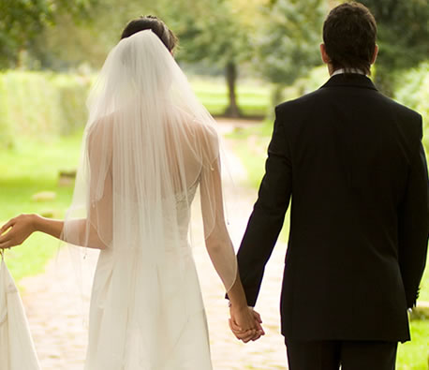
What has happened? (just / get married)
They have just got married.

Slide 10
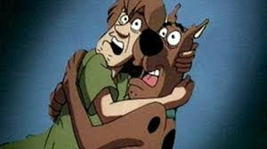
(just / see a ghost)
They have just seen a ghost.

Slide 11
You can try some exercises in your workbook or book as well or online.
See you soon!

