Slide 1
Modal verbs
expressing ability, obligation, prohibition and advice
*SLO:z modalnimi glagoli (modal verbs) izražamo zmožnosti, dolžnosti, prepovedi in nasvete

Slide 2
Modal verbs expressing ability Modalni glagoli za izražanje zmožnosti/sposobnosti
Ability can be both physical or mental. Do you see the difference in sentences below?
A) I can dance and swim. – fizično zmorem
B) My sister can speak French perfectly. – mentalno zmorem
Namesto can lahko uporabimo tudi kakšno drugo besedo. Razmisli, kako bi lahko drugače rekli: I can run faster than my sister. Rešitev:
I am able to run faster than my sister. – namesto CAN smo uporabili BE ABLE TO
TASK: Make the sentence negative and put it in the past tense.
I am able to run faster than my sister → negative → I am not able to run faster than my sister. → past tense → I was not able to run faster than my sister.

Slide 3
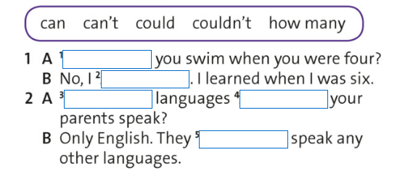
CAN/COULD poleg izražanja zmožnosti uporabljamo tudi za izražanje:
Prošenj (requests):
Can I go to the toilet, please?
Could you tell me where Tom lives?
*could je bolj vljudno kot can
Možnosti (chance):
It could snow tomorrow…
…but I don‘t think so. = Možno je, da bo jutri snežilo (če se jaz s tem strinjam ali ne je popolnoma vseeno).
NALOGA: poskusi dopolniti vajo na sliki. To smo že delali – U, str. 56

Slide 4
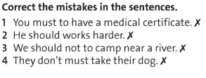
Modal verbs expressing obligation and prohibition Modalni glagoli za izražanje dolžnosti in prepovedi
EXPRESSING OBLIGATION (izražanje dolžnosti):
Do you remember the difference between MUST and HAVE TO? Take a look at the examples:
Oh, my sister has a birthday party next weekend. I must buy her something.
Everyone has to wear slippers at school.
TASK: put both sentences in the past tense. Rešitvi:
I had to buy her something.
Everyone had to wear slippers at school.
TASK 2: put both past tense sentences in the negative. Rešitvi:
I didn‘t have to buy her anything.
Everyone had to wear slippers last year, but…
…now we don‘t have to anymore.
Poglej povedi in poišči napake:

Slide 5
TASK: make questions from the sentences
I must do my HW every day.
→ Must I do my HW every day?
I have to do my homework every day.
→ Do I have to do my homework every day?
TASK 2: make the sentences negative as well:
I mustn‘t do my homework every day. =I‘m not allowed to do it. I don‘t have permission to do it. (=ni mi dovoljeno delati naloge vsak dan! – lahko, da gre za prepoved, četudi zveni smešno).
I don‘t have to do my homework every day. = takšnemu primeru rečemo absence of obligation (=tega ni obvezno narediti)

Slide 6
Prohibition Prepovedi
You mustn‘t shout at school.
Kako bi lahko to poved povedali še drugače / z drugimi besedami? Začni z It is not…
Rešitev:
It is not allowed to shout at school.
TASK: Make some examples with the help of the photos on the right:

Slide 7
Modal verbs expressing advice or suggestion Modalni glagoli za izražanje nasvetov ali predlogov
Should = advice Must = obligation
‘‘You must be fit if you go on the Desert Challenge.‘‘
‘‘You should take a map if you go on the Desert Challenge.‘‘
TASK: GIVE your own example:
A: I am always tired in the morning. What should I do?
B: (I think) You should go to bed earlier. OR …
You shouldn‘t play video games till late at night.
USE should / shouldn‘t OR must / mustn‘t in the exercise on the right:

Slide 8
V ZVEZEK V CELIH POVEDIH: Podnaslov: EXERCISE: must, mustn‘t, can, should, don‘t have to, can‘t
I can hear you quite well. You ___________ not shout.
She__________ ride her bike at night without lights. It's not allowed.
She __________ not eat so much chocolate because it's bad for her figure.
Talk to Ann about your problems. I'm sure she ________ help you.
You ______ vacuum the carpets because Carol has already done it.
Smoking is very unhealthy. You _________ stop it.
You _____________ use a mobile phone in class.
I ____________ ride a bike until I was 8!
We _______________ learn about modal verbs in autumn again! We ________ learn all about them in ZOOM meetings?!

Slide 9
Modal verbs are useful …

